Slide 1

PHS650: Rigor and Reproducibility in the Social, Behavioral, and Population Health Sciences
Dr. Katherine Schaumberg
Wk 5

Slide 2
Working with the IRB*
Consent form language
Be intentional (e.g. ‘original records’; ‘identifiable data’)
Avoid vague statements about data protection
Aim for consistency
IRB Protocols:
Data banking; sharing results; withdrawal of subjects; risks re: de-identified data
Start a dialogue with IRB representatives
Privacy governance may vary across settings
*Template and example available in lecture repo

Slide 3
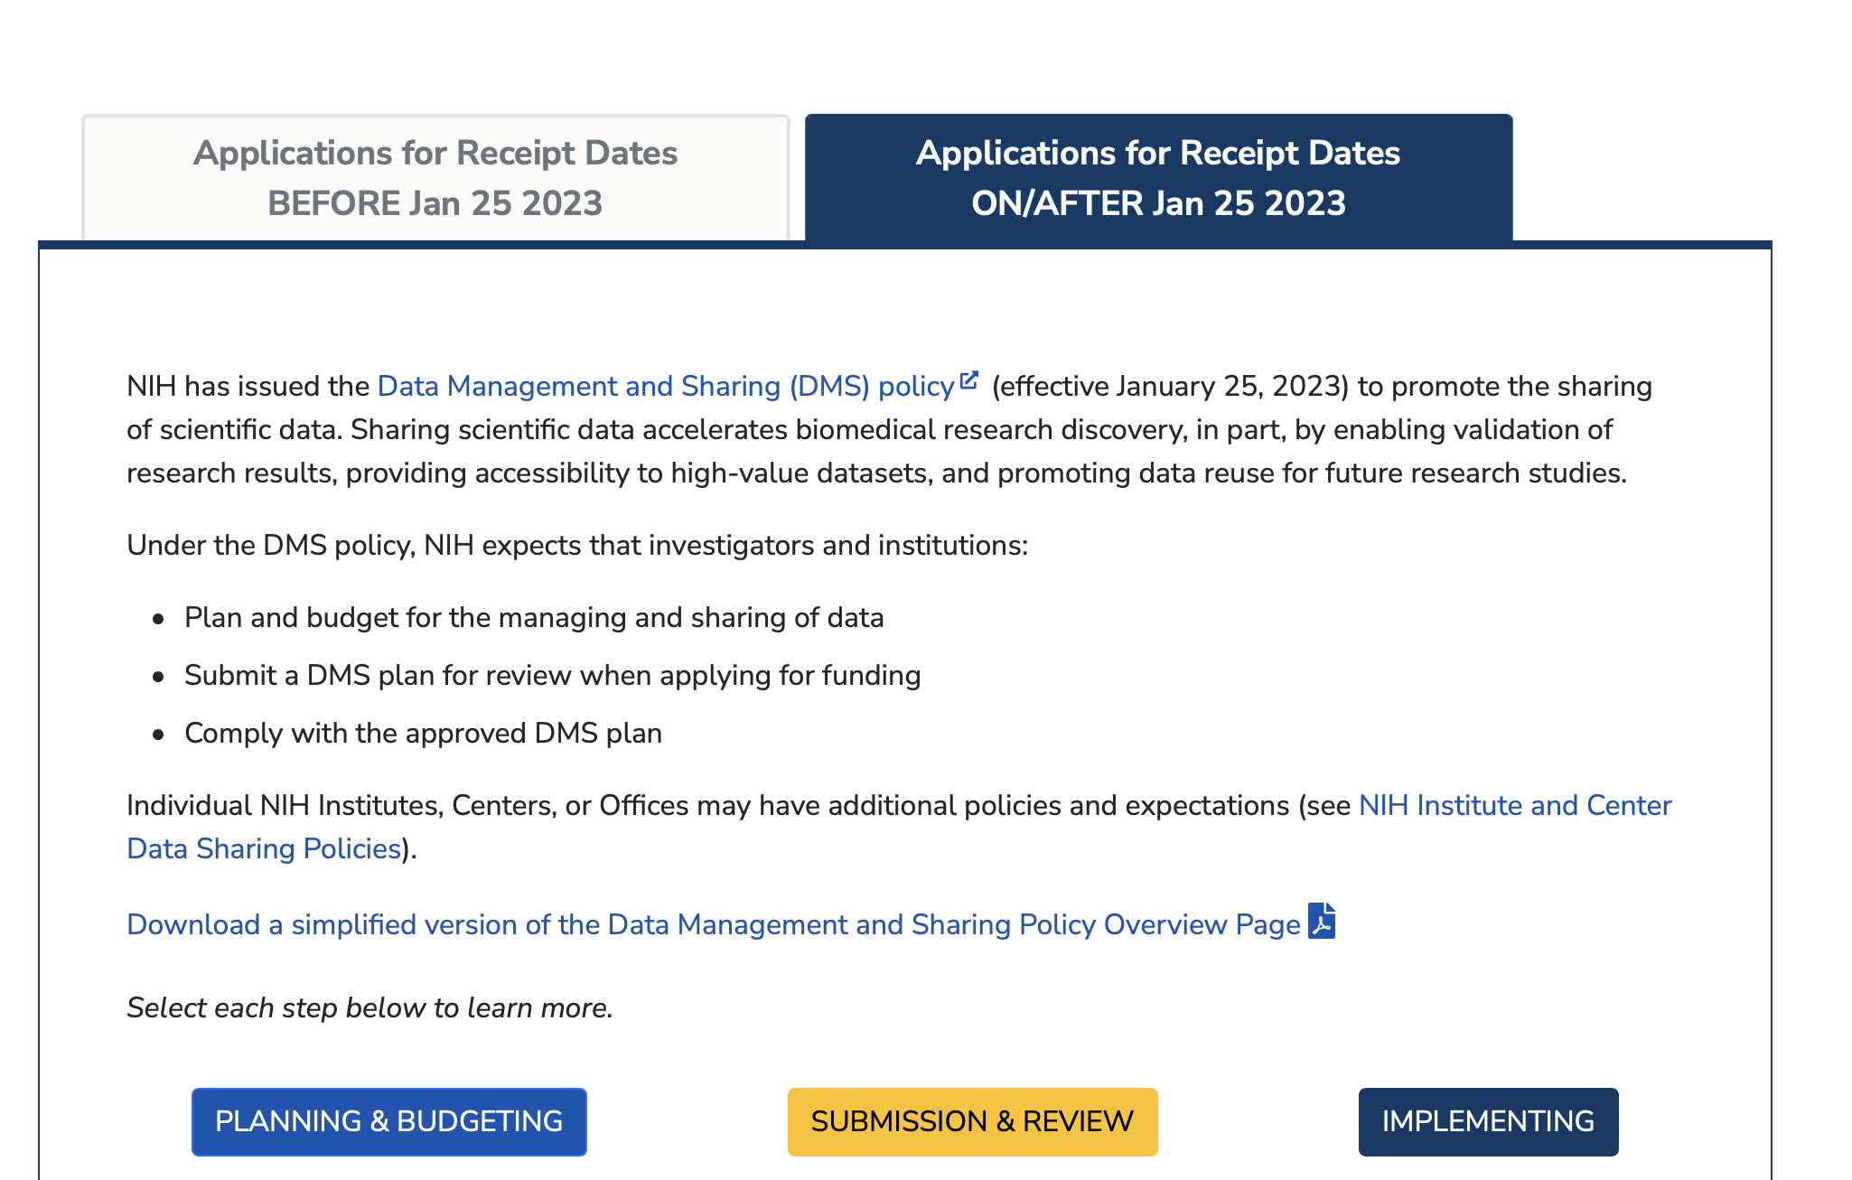
Data Sharing Plans

Slide 4
Elements of a (NIH) data sharing plan*
Data Type
Tools/Software/Code
Standards
Data preservation, access, timelines
Access, distribution, and reuse
Oversight
*Template and example available in lecture repo

Slide 5
Data Transfer/Use Agreements*
Govern data sharing with non-public data
Use for off campus data sharing
Includes:
Description of Data
Description of Project
Institutional official signatures
Dates of Use
Costs of Use
Collaborator Information
*Template and example available in lecture repo

